Slide 1
Broken symmetry, Orbital Hessian, Geometry optimization, Close-lying electronic states, Conformer search
Instructor: Prof. Tzuhsiung (Nick) Yang
Email: tyang@mx.nthu.edu.tw
Time: M5/6
Room: NTHU Library Comp Lab II
Notes:
Rafael Gomez

Slide 2
Suggested reading
Orca manual
Pople, J. A.; Krishnan, R.; Schlegel, H. B.; Binkley, J. S. Derivative Studies in Hartree-Fock and Møller-Plesset Theories. Int. J. Quant. Chem. 1979, 16 (S13), 225–241.
Yamaguchi, K.; Jensen, F.; Dorigo, A.; Houk, K. N. A Spin Correction Procedure for Unrestricted Hartree-Fock and Møller-Plesset Wavefunctions for Singlet Diradicals and Polyradicals. Chemical Physics Letters 1988, 149 (5), 537–542.
Bauernschmitt, R.; Ahlrichs, R. Stability Analysis for Solutions of the Closed Shell Kohn–Sham Equation. J. Chem. Phys. 1996, 104 (22), 9047–9052.
Pracht, P.; Bohle, F.; Grimme, S. Automated Exploration of the Low-Energy Chemical Space with Fast Quantum Chemical Methods. Phys. Chem. Chem. Phys. 2020, 22 (14), 7169–7192.

Slide 3
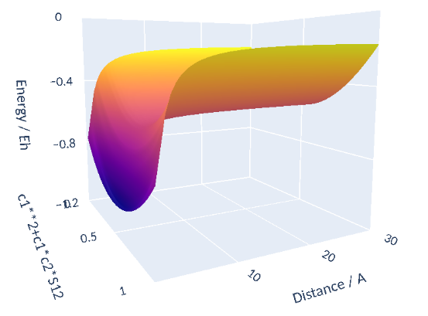
Close-lying electronic states

Slide 4
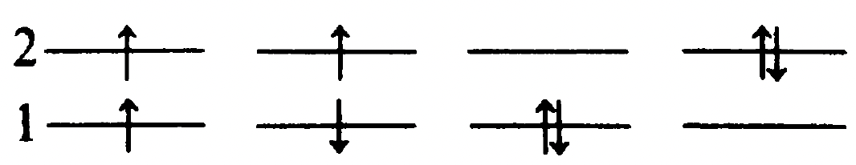
Spin-adapted configurations
There are three types of determinants:
Close-shell (Restricted) determinants
Open-shell restricted determinants
Open-shell unrestricted determinants
Let’s consider the case of two-electron in four spin orbitals, such as Hartree Fock wave function with minimal basis H₂
There are $\left({4 \atop 2}\right)=6$ configurations
(a)
(b)
(c)
(d)
(e)
(f)
The case (a) is the Hartree Fock ground state wave function in the minimal basis H₂, which is a close-shell determinant.

Slide 5
Spin-adapted configurations
(a)
(b)
(c)
(d)
(e)
(f)
The cases (b)-(e) are four singly excited determinants
The open-shell determinants (b) and (c) are eigenfunctions of ${\hat{S}}^{2}$ with eigenvalues of 2 and thus are both triplets:

Slide 6
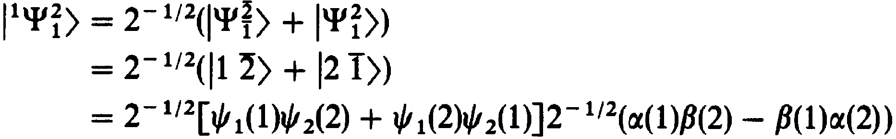
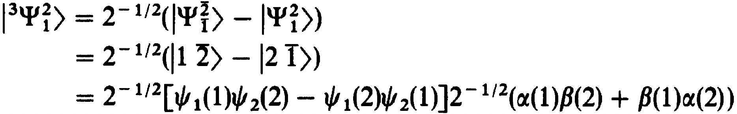
Spin-adapted configurations
(a)
(b)
(c)
(d)
(e)
(f)
For (d) and (e), let’s consider ${\hat{S}}_{−}{\hat{S}}_{+}\left|\left.1\overline{2}\right\rangle \right.$. By chain rule, the first operation will generate${\hat{S}}_{−}\left(0+\left|\left.12\right\rangle \right.\right)$ and the second operation will generate $\left|\left.\overline{1}2\right\rangle \right.+\left|\left.1\overline{2}\right\rangle \right.$. Therefore, the eigenfunction is a linear combination of (d) and (e).

Slide 7
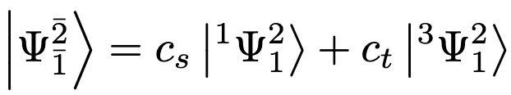
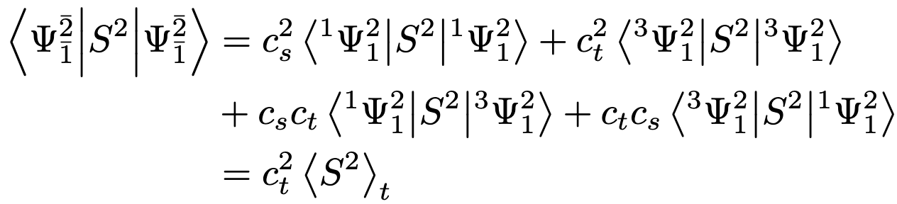
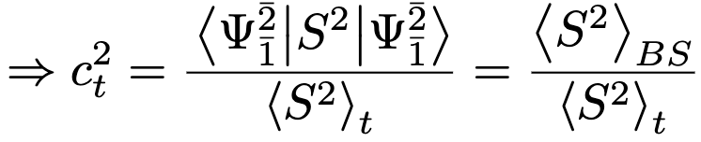
Broken symmetry state
The single determinant broken symmetry (BS) state can be written as a linear combination of the two SACs
The S² expectation value of the BS wavefunction is
Pople, J. A.; Krishnan, R.; Schlegel, H. B.; Binkley, J. S. Derivative Studies in Hartree-Fock and Møller-Plesset Theories. Int. J. Quant. Chem. 1979, 16 (S13), 225–241.

Slide 8
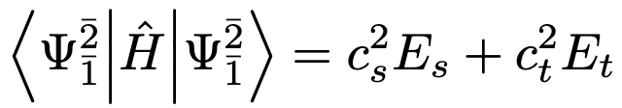
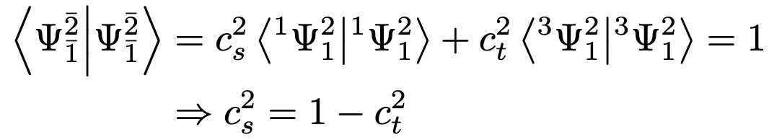
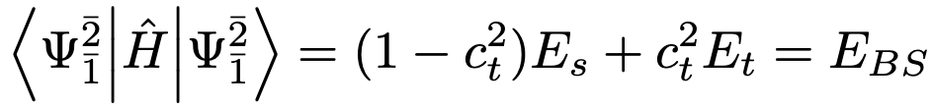
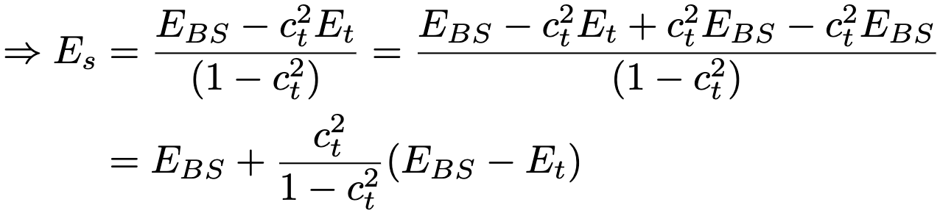
Broken symmetry state
The energy of the BS state
By orthonormality relation,
Hence, the energy of the BS and pure state
Pople, J. A.; Krishnan, R.; Schlegel, H. B.; Binkley, J. S. Derivative Studies in Hartree-Fock and Møller-Plesset Theories. Int. J. Quant. Chem. 1979, 16 (S13), 225–241.

Slide 9
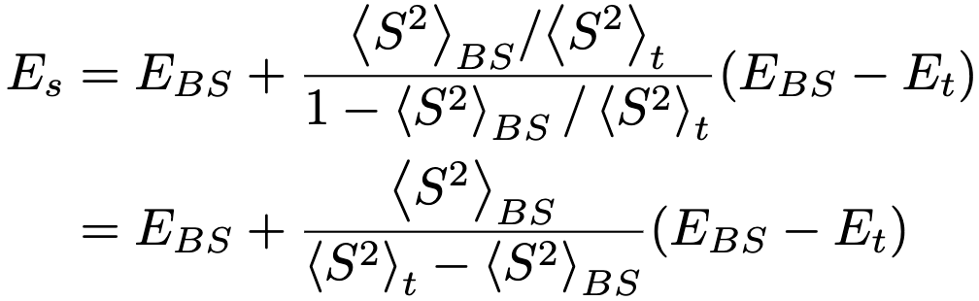
Spin purification
Substitute $c_{t}^{2}$ by the S² expectation values
$E_{t}$ can be obtained from any of the triplet wavefunctions
This process of correcting the energy of the BS state using the S² value of the BS and triplet states and the energy of the triplet state is called spin purification.
Pople, J. A.; Krishnan, R.; Schlegel, H. B.; Binkley, J. S. Derivative Studies in Hartree-Fock and Møller-Plesset Theories. Int. J. Quant. Chem. 1979, 16 (S13), 225–241.

Slide 10
Interactive
Navigate to CompChem/Practice/Week5/Exercise1
qsub h2_r.sub
qstat -u ${USER}
Repeat 3 until the job is done
Plot the results using H2_stretching_sd.ipynb

Slide 11
Interactive
Navigate to CompChem/Practice/Week5/Exercise2
qsub h2_r.sub
qstat -u ${USER}
Repeat 3 until the job is done
Plot the results using H2_stretching_sp.ipynb

Slide 12
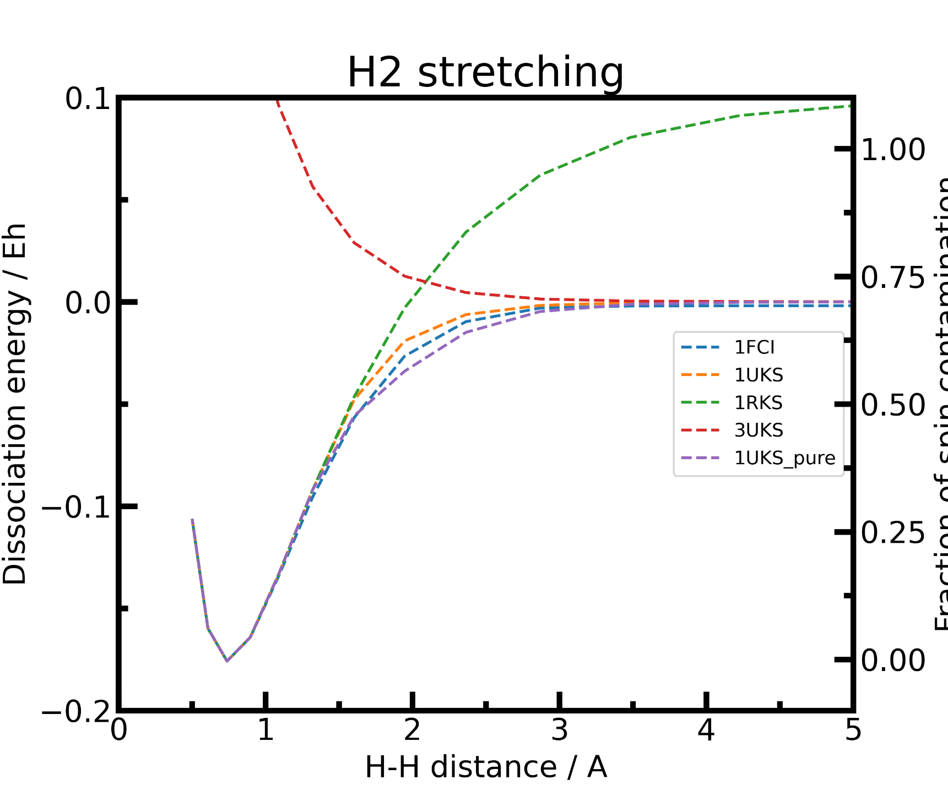

Slide 13
Orbital Hessian
Since there are so many states possible at a given set of q, how do we know that we are at the right state (or find out that we are at the wrong state?)
Since the converged KS wavefunctions are stable with respect to orbital rotation (Brilluoin’s theorm)—the exchange of occupied and virtual orbitals results in an increase in energy. We will need to find the second derivative of energy with respect to orbital coefficients (orbital Hessian).
Bauernschmitt, R.; Ahlrichs, R. Stability Analysis for Solutions of the Closed Shell Kohn–Sham Equation. J. Chem. Phys. 1996, 104 (22), 9047–9052.
Seeger, R.; Pople, J. A. Self‐consistent Molecular Orbital Methods. XVIII. Constraints and Stability in Hartree–Fock Theory. J. Chem. Phys. 1977, 66 (7), 3045–3050.

Slide 14
Orbital Hessian
We will not go into deriving the analytic form for orbital Hessian in this class. Instead, we will talk about three types of SCF instabilities:
The first constraint that is almost universally applied is to assume the spin orbitals depend only on one or other of the spin-functions α or β.
“4.5.9 Internal Stability Analysis and Automated Correction for Energy Minima” https://manual.q-chem.com/5.2/Ch4.S5.SS9.html (accessed on 3/26/23)

Slide 15
Orbital Hessian
We will go into deriving the analytic form for orbital Hessian because it is too complicated. Instead, we will talk about three types of SCF instabilities:
The first constraint that is almost universally applied is to assume the spin orbitals depend only on one or other of the spin-functions α or β.
Most SCF calculations use real functions, and this places an additional constraint on the form of the wave function. If there exists a complex solution to the SCF equations that has a lower energy, the wave function exhibits a real → complex instability.
“4.5.9 Internal Stability Analysis and Automated Correction for Energy Minima” https://manual.q-chem.com/5.2/Ch4.S5.SS9.html (accessed on 3/26/23)

Slide 16
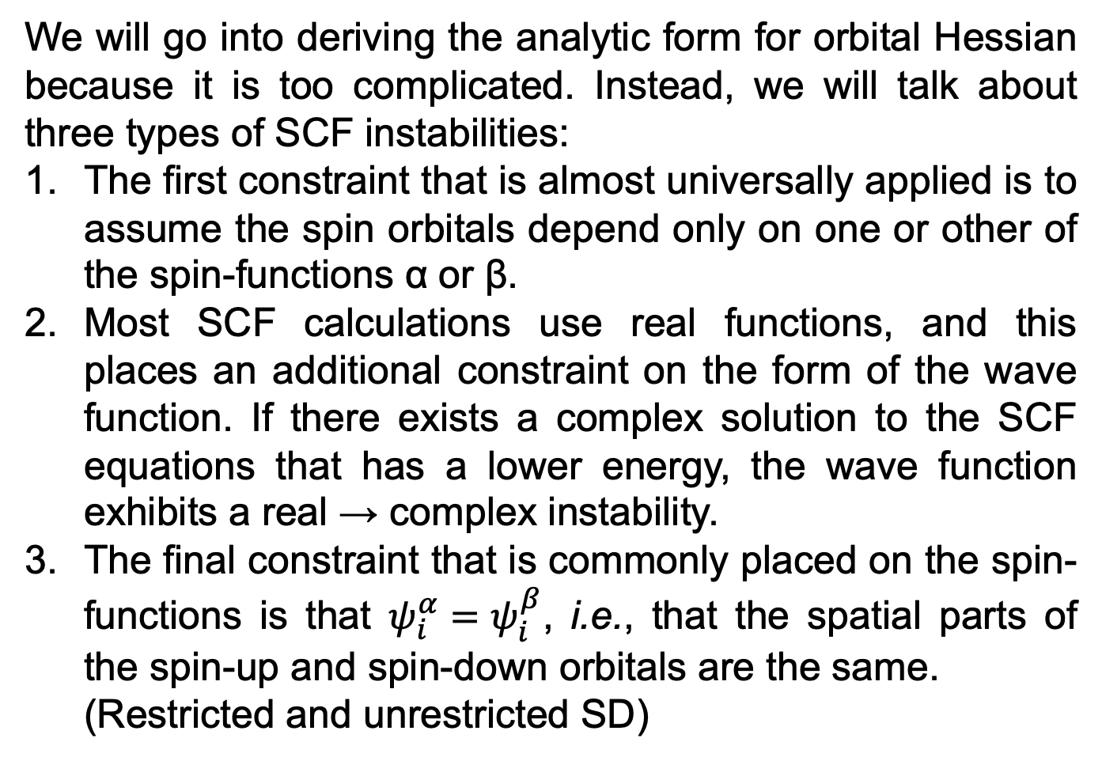
Orbital Hessian
We will go into deriving the analytic form for orbital Hessian because it is too complicated. Instead, we will talk about three types of SCF instabilities:
The first constraint that is almost universally applied is to assume the spin orbitals depend only on one or other of the spin-functions α or β.
Most SCF calculations use real functions, and this places an additional constraint on the form of the wave function. If there exists a complex solution to the SCF equations that has a lower energy, the wave function exhibits a real → complex instability.
The final constraint that is commonly placed on the spin-functions is that $ψ_{i}^{α}=ψ_{i}^{β}$, i.e., that the spatial parts of the spin-up and spin-down orbitals are the same.
(Restricted and unrestricted SD)
“4.5.9 Internal Stability Analysis and Automated Correction for Energy Minima” https://manual.q-chem.com/5.2/Ch4.S5.SS9.html (accessed on 3/26/23)

Slide 17
Interactive
Navigate to CompChem/Practice/Week5/Exercise3
qsub h2_stability.sub
qstat -u ${USER}
Repeat 3 until the job is done
vi the output file and look for the stability analysis section

Slide 18
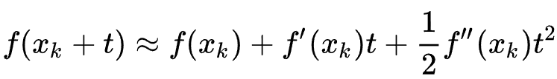
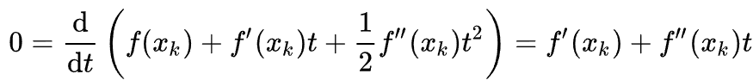
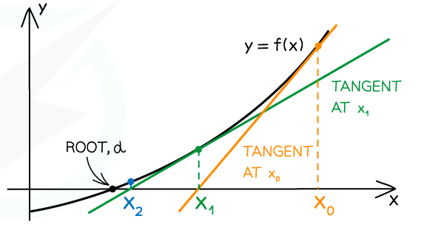
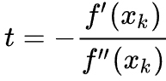
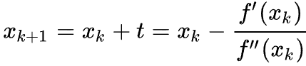
Geometry optimization
The goal of geometry optimization is to find a local minimum on the potential energy surface (PES). In the language of optimization, it is to minimize energy w.r.t nuclear coordinates. One method is Newton-Raphson method.
At a minimum,
Hence, the step size is
The updated step is

Slide 19
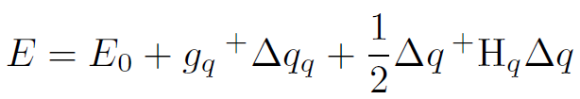
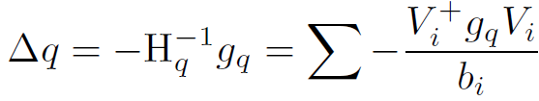
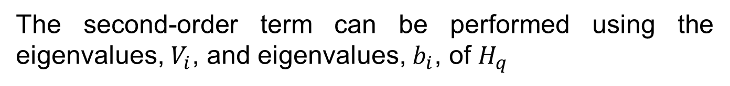
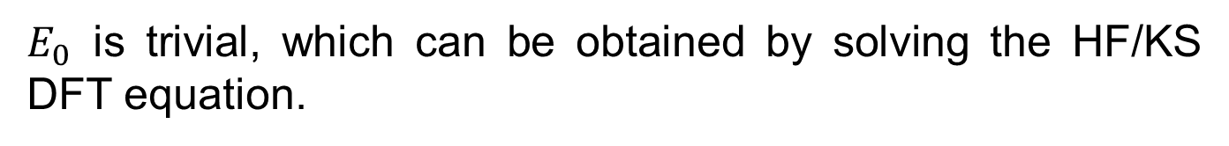
Geometry optimization
Similar, we can optimize the energy of the system, which is a function of nuclear coordinates
is the energy at the initial coordinate, is the transpose of the nuclear gradient vector, is the step size of update,
is the nuclear Hessian.
The second-order term can be performed using the eigenvalues, $V_{i}$, and eigenvalues, $b_{i}$, of $H_{q}$
This requires us to obtain three quantities: $E_{0}$, $g_{q}$, and $H_{q}$
$E_{0}$ is trivial, which can be obtained by solving the HF/KS DFT equation.

Slide 20
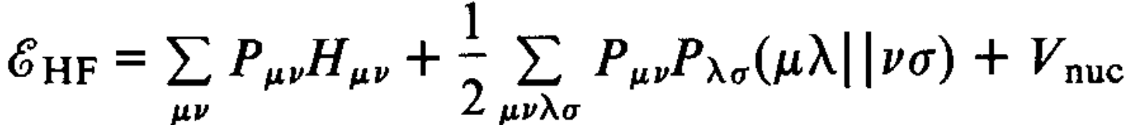
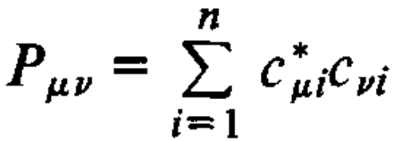
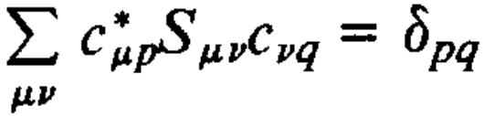
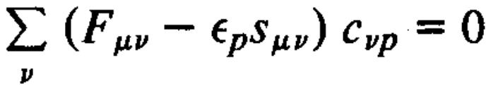
Nuclear gradient
How do we obtain the nuclear gradient of E(q)?
Recall that the HF equation for total energy is
Properties of the MO coefficients
,
And Fock matrix equation
Pople, J. A.; Krishnan, R.; Schlegel, H. B.; Binkley, J. S. Derivative Studies in Hartree-Fock and Møller-Plesset Theories. Int. J. Quant. Chem. 1979, 16 (S13), 225–241.

Slide 21
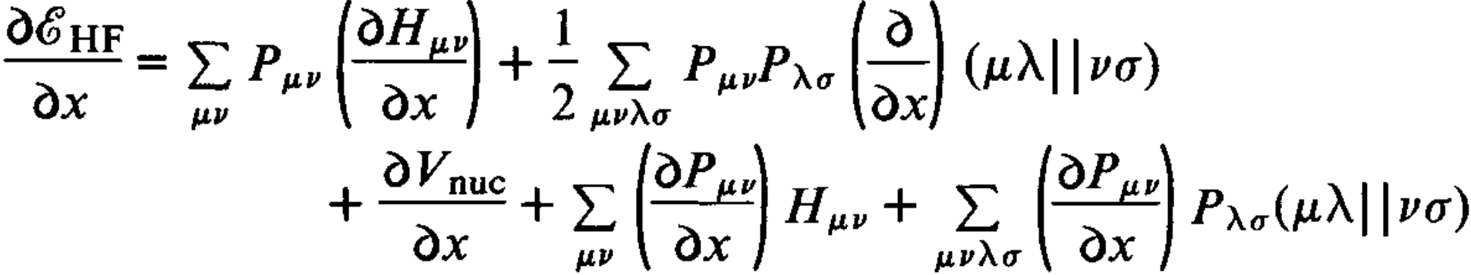
Nuclear gradient
How do we obtain the nuclear gradient of E(q)?
The first derivative with respect to the nuclear coordinate x
The first three terms involve the derivatives of some GFs and or coulombic terms, which are not hard to evaluate.
However, the derivatives of the density matrix are hard to evaluate.
Pople, J. A.; Krishnan, R.; Schlegel, H. B.; Binkley, J. S. Derivative Studies in Hartree-Fock and Møller-Plesset Theories. Int. J. Quant. Chem. 1979, 16 (S13), 225–241.

Slide 22
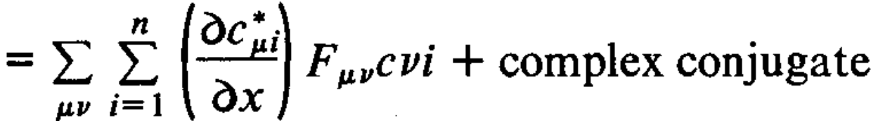
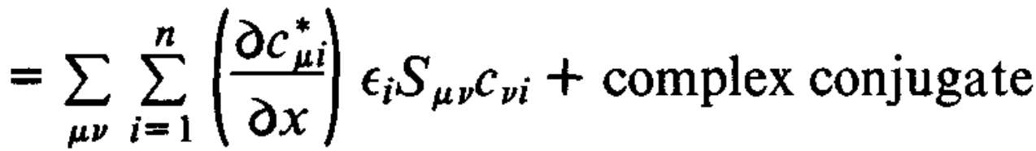
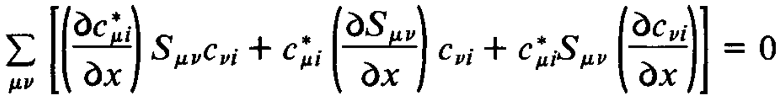
Nuclear gradient
Luckily, if we expand them and observe
because of the Fock equation
Furthermore, if we differentiate the orthonormality equation by the chain rule, we obtain an expression for
Pople, J. A.; Krishnan, R.; Schlegel, H. B.; Binkley, J. S. Derivative Studies in Hartree-Fock and Møller-Plesset Theories. Int. J. Quant. Chem. 1979, 16 (S13), 225–241.

Slide 23
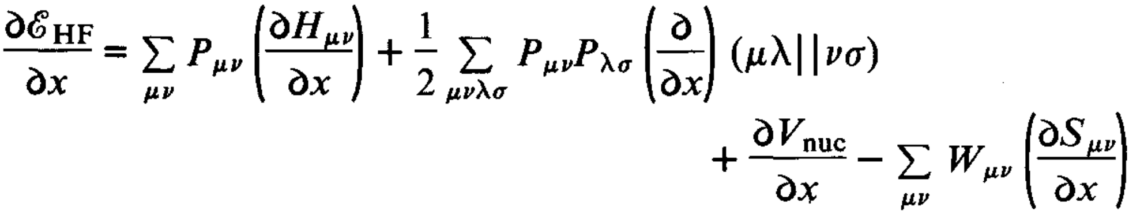
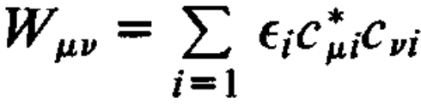
Nuclear gradient
Hence, the nuclear first derivation of the HF equation is
where is the “energy-weighted density matrix”
Pople, J. A.; Krishnan, R.; Schlegel, H. B.; Binkley, J. S. Derivative Studies in Hartree-Fock and Møller-Plesset Theories. Int. J. Quant. Chem. 1979, 16 (S13), 225–241.

Slide 24
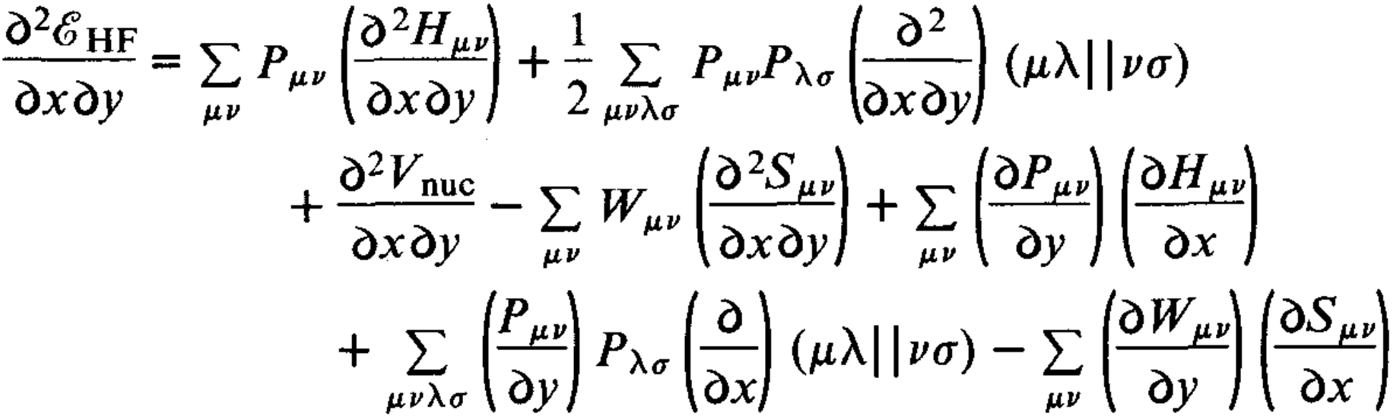
Nuclear gradient
Unfortunately, we can’t avoid solving for the derivative of the density matrix for the second derivative.
The derivatives of the density matrix can be accomplished by the coupled-perturbed HF theory, which is too costly to evaluate for the purpose of geometry optimization.
Pople, J. A.; Krishnan, R.; Schlegel, H. B.; Binkley, J. S. Derivative Studies in Hartree-Fock and Møller-Plesset Theories. Int. J. Quant. Chem. 1979, 16 (S13), 225–241.

Slide 25
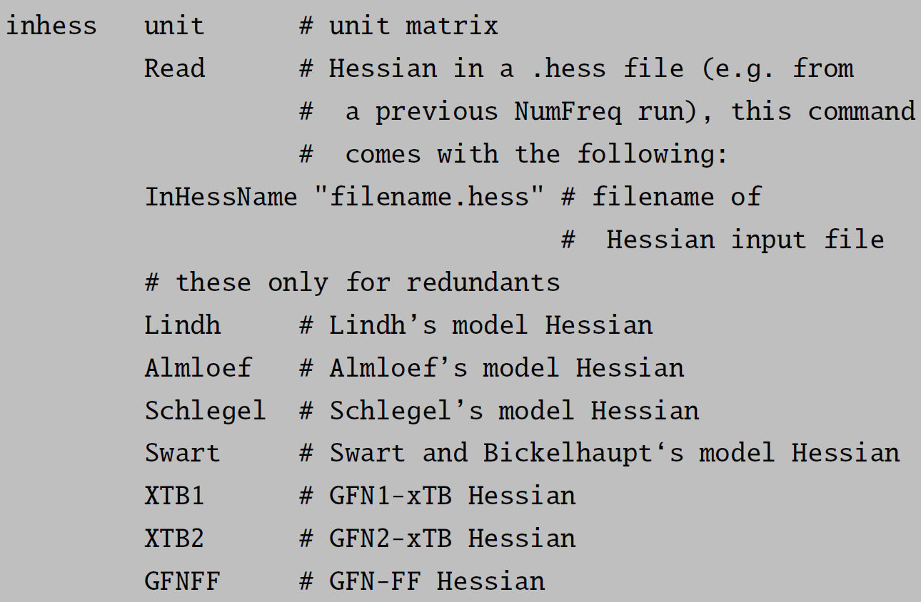
Guess Hessian
Instead, for geometry optimization using the Newton-Raphson method, guessed Hessian matrices will be used.

Slide 26
Geometry optimization
Convert SI units to atomic units (Å to Bohr)
Convert cartesian to internal coordinates (Z-matrix)
Form a guess Hessian in internal coordinates
Converge SCF at the current internal coordinates
Calculate the gradient of energy (force) using the equation just described.
Convert the cartesian gradient into internal gradient
Calculate displacement by Hessian and gradient (Newton’s method)
Update coordinates in internal coordinates
Update guessed Hessian
Repeat step 4 to 9 until the energy no longer changes
Convert internal to cartesian coordinates
Convert atomic units to SI units

Slide 27
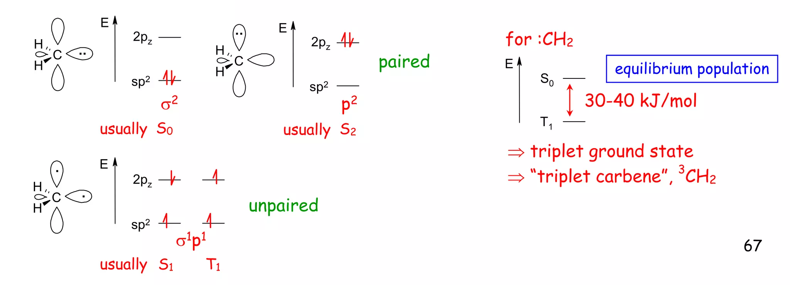
Interactive
Carbenes contain hypovalent carbon centers that have 2e2o to form different configurations (SACs). Carbenes have diverse reactivity, which depends on their spin ground state (see below). In this exercise, we will optimize the simplest carbene, CH₂, at different electronic ground states.

Slide 28
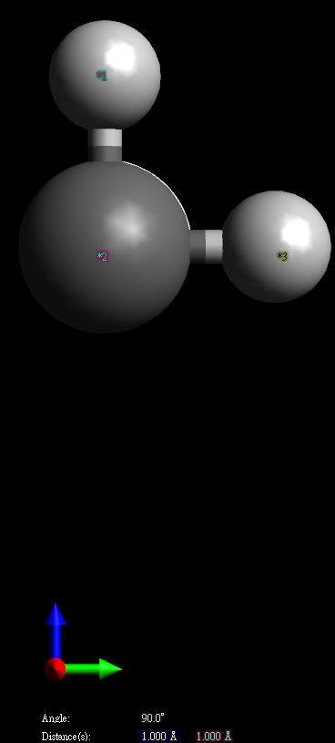
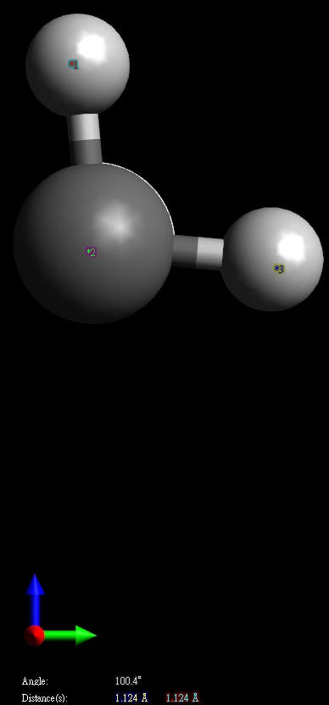
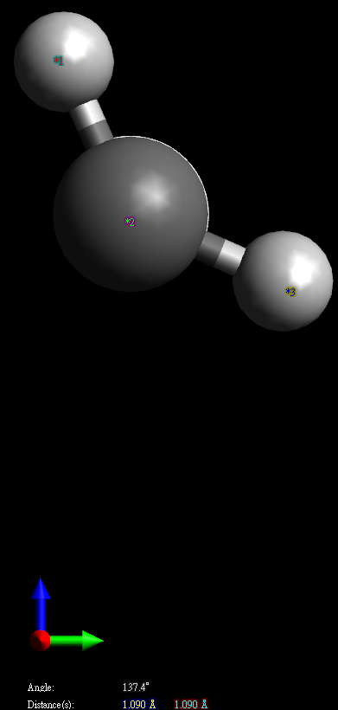
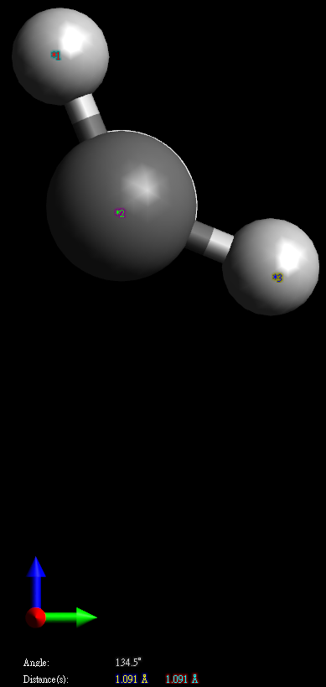
Interactive
Initial
CS
BS
T

Slide 29
Interactive
Navigate to CompChem/Practice/Week5/Exercise4
qsub ch2_opt.sub
qstat -u ${USER}
Repeat 3 until the job is done
Export xyz files and _trj.xyz files and view/animate them by Avogadro

Slide 30
Interactive
Plot the orbitals from CH2_0_1_ub3lyp_def2-svp_R-BS.opt.gbw for analysis
module load orca/4.2
orca CH2_0_1_ub3lyp_def2-svp_R-BS.opt.gbw -i
1 1 2 3 3 0 4 80 5 7 10 3 1 10
export CH2_0_1_ub3lyp_def2-svp_R-BS.opt.mo3a.cube and CH2_0_1_ub3lyp_def2-svp_R-BS.mo3b.cude
View the orbitals by Avogadro by Extensions -> Create Surfaces -> Surface Type (Molecular orbital) -> Calculate

Slide 31
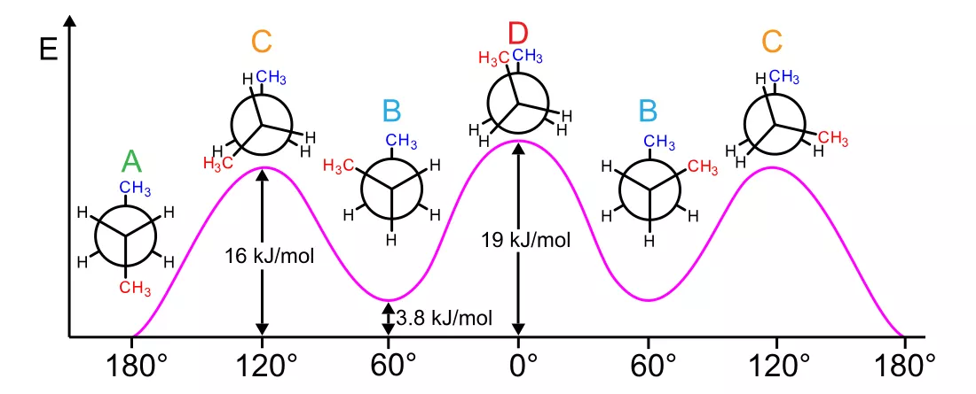
Conformer
Two main search strategies are used to generate a conformational ensemble: systematic and stochastic:
In the first approach, each rotatable bond is sampled systematically in discrete intervals, limiting the use to molecules with few rotatable bonds.
Stochastic methods on the other hand sample the conformational space of a molecule randomly and can thus be applied to more flexible molecules.

Slide 32
Interactive
Navigate to CompChem/Practice/Week5/Exercise5
qsub conformer.sub
Export xyz files and _trj.xyz files and view/animate them by Avogadro
obabel C4H10.xyz -O confs.sdf --confab --conf 30
Export confs.sdf and view the conformers by Avogadro by View -> Properties -> Conformer Properties
Once the submitted job is complete, export crest_conformers.xyz and view the confomers by Avogadro

